Slide 1
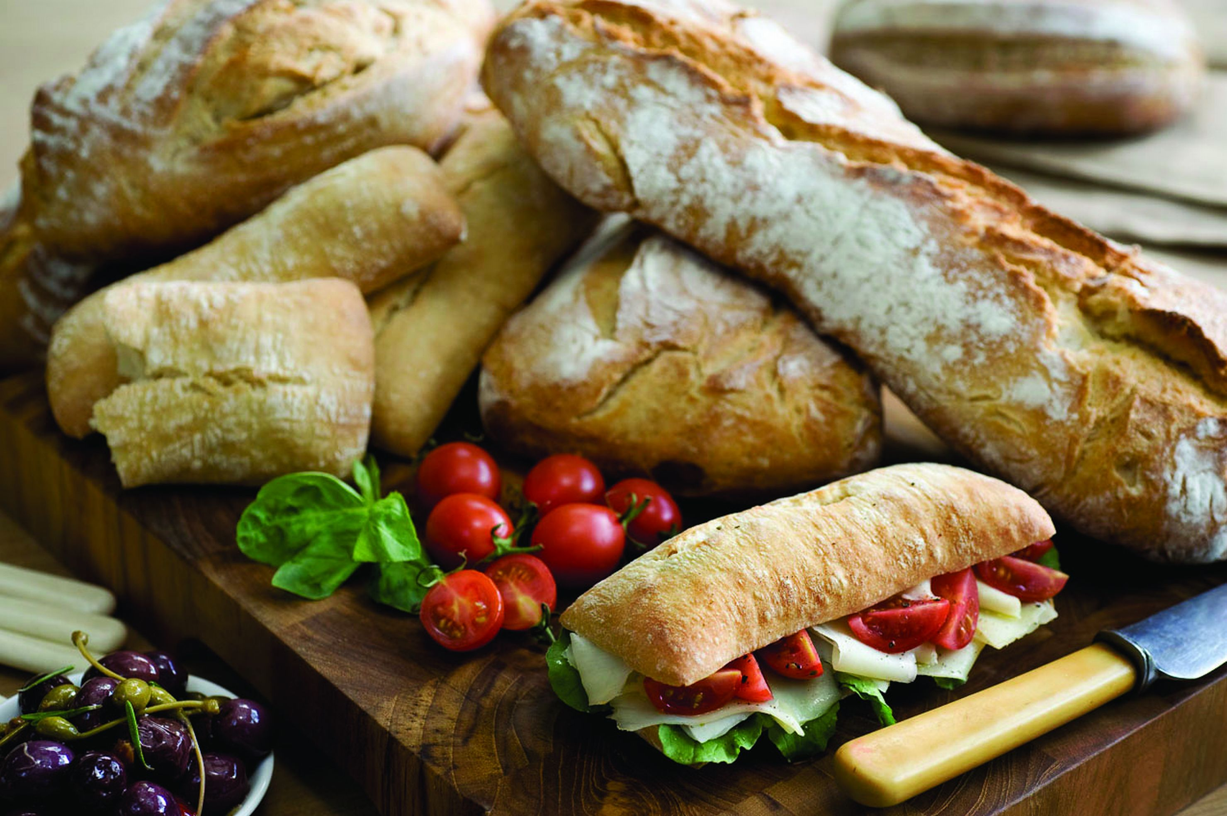

Hospitality Appliances Pvt. Ltd.
MADE IN INDIA…FOR INDIA !

Slide 2

INDEX
Welcome to MGPRO________________________________________Page 3
Core Team________________________________________________Page 4
Manufacturing____________________________________________Page 5
Environment First__________________________________________Page 6
Installation and Servicing____________________________________Page 7
MGPRO vs the Competition_____________________________Pages 7,8 & 9
Quality Policy_____________________________________________Page 10
Our Brands_______________________________________________Page 11
Solutions & Key Clients______________________________________Page 12
Professional Refrigeration________________________Pages 13, 14, 15 & 16
Blast Chillers/Freezers & Ice Cube Makers_______________________Page 17
Showcases____________________________________Pages 18, 19, 20 & 21
Multideck Coolers_________________________________Pages 22, 23 & 24
Bar Coolers___________________________________Pages 25, 26, 27 & 28
Bars & Coffee Shop Design__________________________________Page 29
Project Management______________________________________Page 30
Contact Information_______________________________________Page 31

Slide 3
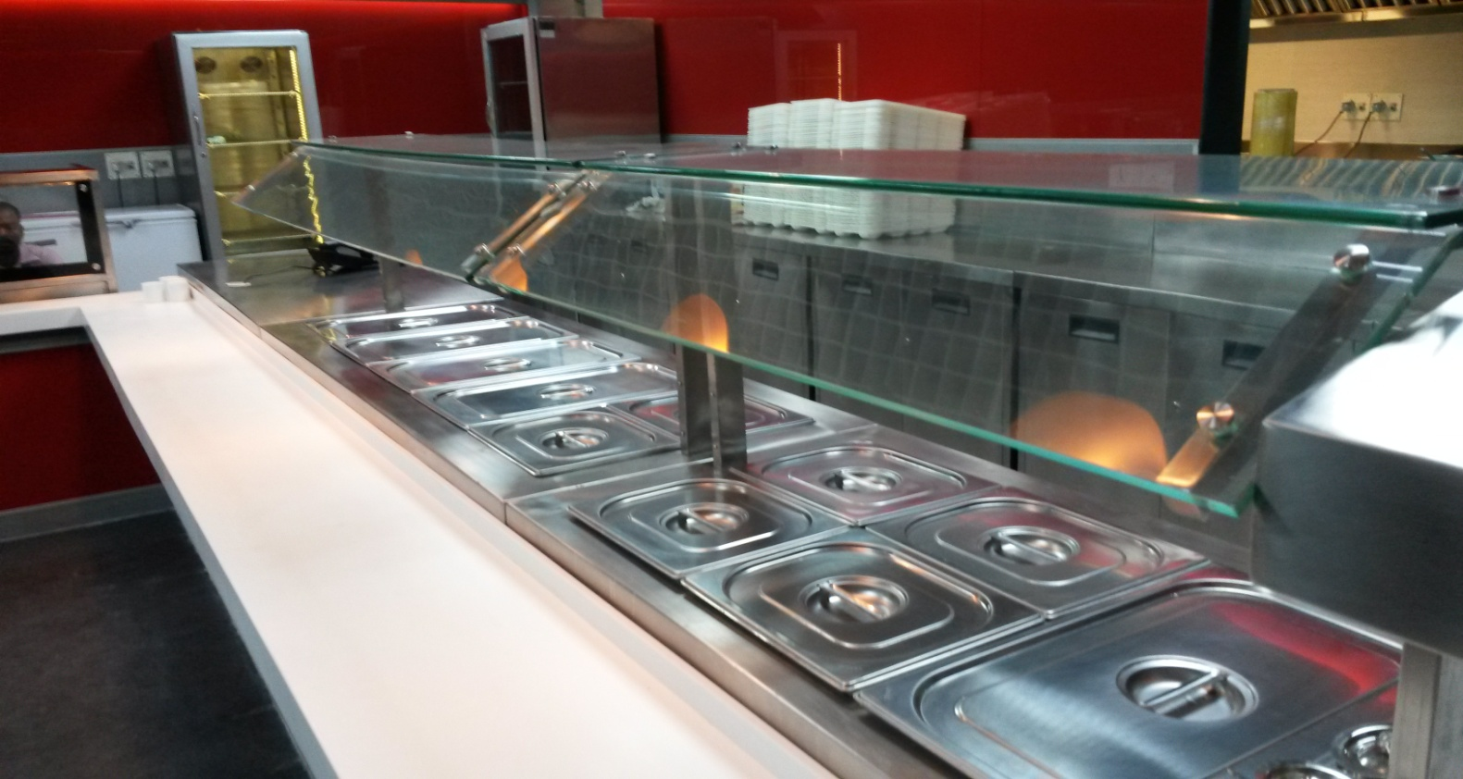
Welcome To MGPRO
Commercial refrigeration brought to you by people with over 35 years combined industry experience. We know what matters most in a busy, demanding kitchen: simple, reliable, flexible products, backed by unparalleled customer service. From gastro-norm cabinets and counters to multideck chillers/showcases and bottle coolers, MGPRO’s refrigeration is MADE IN INDIA FOR INDIA and meets the needs of the most demanding customers.
Established in 1982, the company draws on a wealth of industry knowledge, not least from managing director and owner, Mukesh Ganjawalla (MG). MG has literally grown up in the refrigeration industry, working for his family business. He’s done everything, from fitting compressors on the production line to managing sales and manufacturing set up’s.
The group owes the success of its equipment to its innovation and a strong emphasis on quality and service. If there is anything MG is extremely proud of, then that would be the Pan India after sales service back up. That he says is his first baby!
The Mukesh Ganjawalla group manufactures truly international range of professional kitchen and refrigeration equipment for hotels, restaurants, cafes, flights kitchens, industrial kitchen, etc. at its manufacturing facility situated in Silvassa by the name of Ganjawalla Fabripro Pvt. Ltd. The MG Group deals in some of the world’s most trusted foodservice equipment manufacturers and has its own line of refrigeration equipment called MGPRO.
A refrigerator is the only essential piece of catering equipment to keep operating 24 hours a day, 365 days a year. Reliability and sustainability are highly significant to a professional refrigerator. They are also the product commitments of MGPRO.

Slide 4

CORE TEAM
Management team
Mukesh Ganjawalla enterprises is a family owned / operated company based out of Mumbai with manufacturing operations at Ganjawalla FabriPro Pvt. Ltd. in Silvassa.
Mukesh Ganjawalla Chairman and managing director
Mukesh Ganjawalla comes with a rich experience off over 35 years in the industry. Started off as a supplier of ice cubes and ice cube making machines on rental, he today has come a long way ahead with a vision of taking the cooling products industry in India towards being international. He leads the strategic thinking and planning. He is based in Mumbai.
Dhanashri Ganjawalla Chief Financial Controller
Dhanashri Ganjawalla is Mukesh Ganjawalla’s wife and business partner from the time the company was formed. She has led the company’s Administration, Financial Planning and Profit Centre Operations since its conception.
Harshal Ganjawalla Director
With an extensive training experience in large and internationally reputed refrigeration factories in China, Harshal Ganjawalla leads the manufacturing division (Ganjawalla FabriPro Pvt. Ltd.) of the group and is based out of Silvassa (UT of Dadra and Nagar Haveli). With concentration on developing innovative, reliable, efficient and aesthetically appealing products at the factory, he manages the timely project deliveries, with tremendous cost and quality control.
Pranal Ganjawalla Director
Pranal Ganjawalla is a management graduate from Manchester University (UK) with work experience in companies such as Foster refrigeration, etc. With serious in-depth knowledge and understanding of the working of the latest & most efficient products internationally and the aim to provide turnkey solutions with the best possible logistics, Pranal is leading the way forward for the company when it comes to sales, marketing and project handling. He is based in Mumbai.

Slide 5

MANUFACTURING
Ganjawalla FabriPro Pvt. Ltd. (GFPL) is a manufacturing facility based in Silvassa which is situated in the Union Territory of Dadra and Nagar Haveli. It manufactures its own line of innovative food service, bar and refrigeration equipment called MGPRO, developed to an uncompromised level of quality and durability, targeting the quality and price conscious food and beverage operators.
GFPL keeps striving to meet individual customer requirements, with cutting-edge designs, while meeting the latest energy, environmental and food safety legislation...products that are robust, good looking, reliable, energy efficient and very cost effective.
Products are tested to perform under extreme conditions…similar to the conditions we have in kitchen and commercial outfits in India. No products are launched unless it is tested to perform under rugged Indian environmental conditions. Over and above everything, 90% of our electrical and wear n tear components are freely available in the local markets across India for the best possible service back-up. In short, this MGPRO range is Made in India, for India!
The scale of manufacturing facilitates the cost to be kept to the bare minimum and allows us to invest into research and development towards better technology, energy efficiency, environmental friendliness and aesthetics. Driven by large supplies to various parts of India, Middle East and Africa, MGPRO products go through some of the most stringent quality control testing, thereby ensuring consistency.

Slide 6


ENVIRONMENT FIRST
The MG group recognizes the increasing importance and need to safeguard our environment and also to assist our clients in the efficient and effective operation of their equipment. We strive to enhance the duty of care and support we can provide to end users in aspects such as cleaning, hygiene, energy consumption, acoustics and through the whole life costs of the equipment, including safe and environmentally correct disposal.
All cabinets, display cases, back bar and all SS equipment are manufactured using CFC free, HCFC free, ODP zero PU foam insulation. All refrigerants offered by MG comply with the latest legislation and environmental regulation. Currently R134a and R404a are in use, however in enhancing both performance and environmental protection and awareness.
Throughout the production and manufacturing process, we strive to minimise waste and its environmental impact and re-use and recycle a number of raw materials entering the business, including:
Metal - Re-used or recycled via approved scrap metal merchants
Plastics - Recycled via the manufacturer/supplier for re-grading
Timber - Pallets re-used and returned to the supplier
Cardboard - Recycled
Waste chemicals and fluids are duly disposed of via approved and regulated contractors.
MGPRO product design is focussed to user application and needs. We equally bring engineering excellence and benefit through duty of care, service and operating performance. MG - PRO product developments incorporate latest technology to reduce energy consumption and acoustic levels without impairing product performance and service support.
Examples of such included on all MG - PRO products are:
Balloon profile, easy clean and longer life gaskets enhancing whole life costs
Enhanced controls and temperature monitoring systems
Mono bloc refrigeration units for tremendous energy efficiency
Recycled paper and wooden packing material is used for packing
We hope this brief introduction proves of value and assurance to you of our awareness to the environment and if we can offer any further guidance or support then please do not hesitate to contact us.

Slide 7
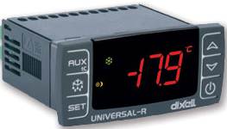
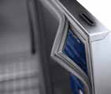

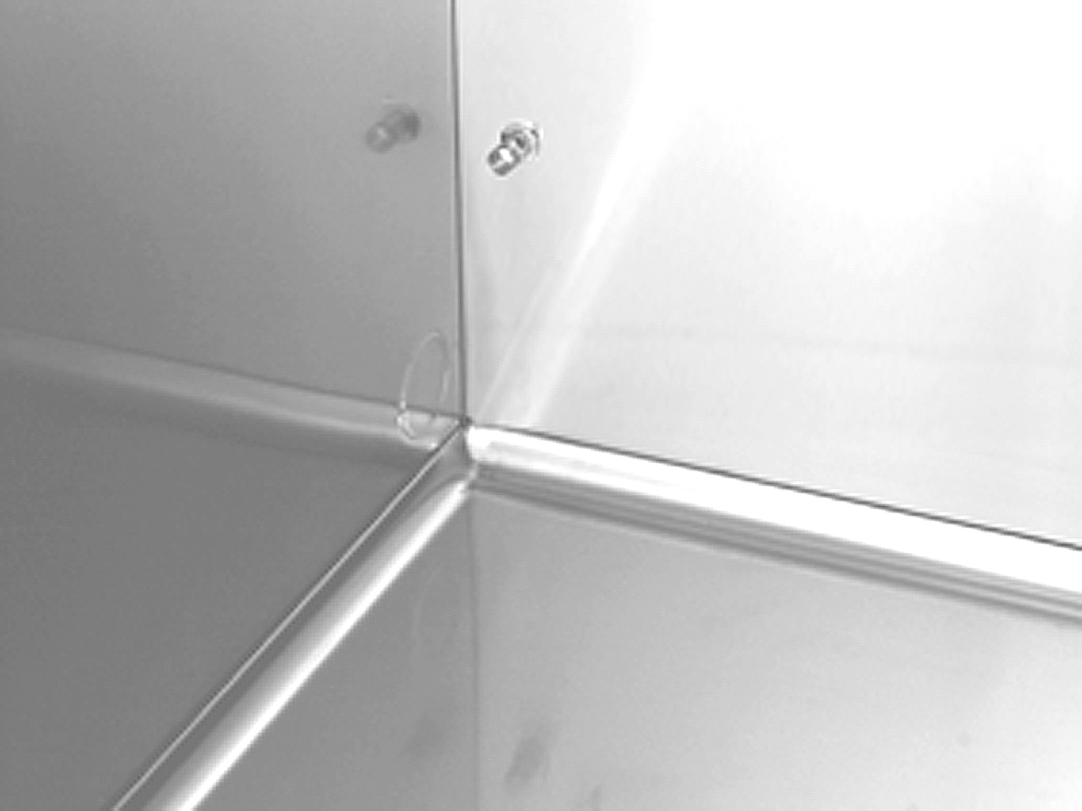
MGPRO Vs The Competition
Know the difference
MGPRO'S STAINLESS STEEL
Stainless steel is generally regarded as the best material to use in a commercial kitchen environment. All good quality kitchen equipment is made of stainless steel, especially where it comes into direct contact with food - such as in the interior of a fridge. Stainless steel is harder wearing, easier to clean, more hygienic and lasts longer than Aluminium and/or plastic.
- 2 TO +4°C REFRIGERATOR TEMPERATURE RANGE
MGPRO’s upright gastro-norm cabinet and gastro-norm counter refrigerators are designed to operate between -2ºC and +4ºC meaning they can be used to store, General Produce, Meat or Fish products. Our competitor’s refrigerators are only capable of +2° to +4°C; due to the lack of a superior heated defrost system which is fitted as standard on the MGPRO units.
Controllers are water proof of Dixell make with intelligent automatic defrosting which ensures that the evaporator is working on optimum performance.
PRESS TYPE MAGNETIC DOOR GASKETS
MGPRO’s products typically come with removable door gaskets. This makes it very easy to clean and maintain as and when required.
ELECTRIC MULLION HEATERS
Anti-condensation on the mouth of the refrigerator and prevents potential dirt traps.
ROUND CORNERS FOR EASY CLEANING
All MGPRO models come with coved / round corners for ease during cleaning.

Slide 8
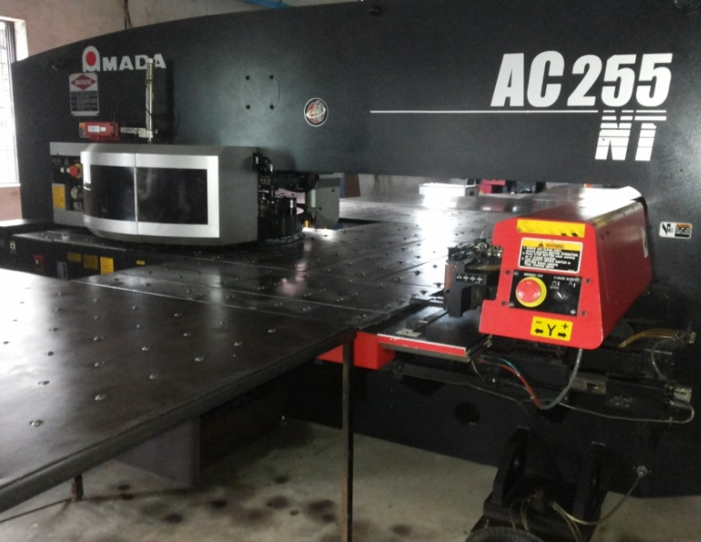
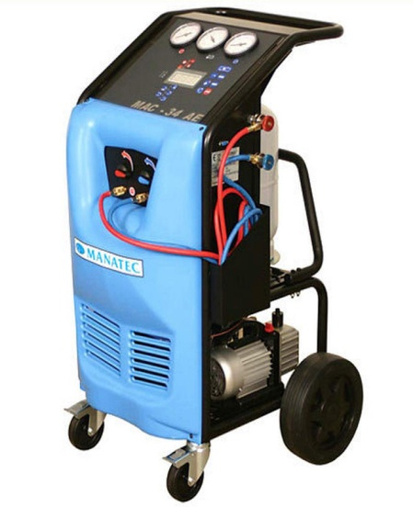
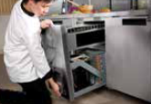
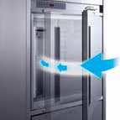
SUPERIOR TECHNOLOGY
MGPRO products come with superior finishing and performance thanks to the automation available for fabrication, condensing unit assembly and testing. Condensing units in all under counter models are Mono-Bloc removable units for easy maintenance.
AMADA CNC Turret Punching
Automatic gas charging station
Mono-Bloc refrigeration units
SELF CLOSING DOORS
Self-closing doors minimise cool air loss and reduce energy consumption

Slide 9
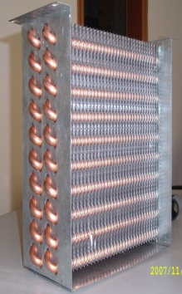
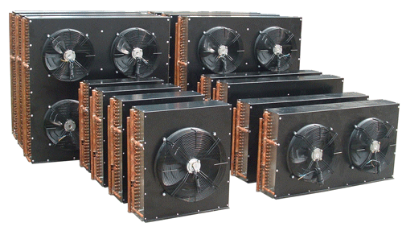
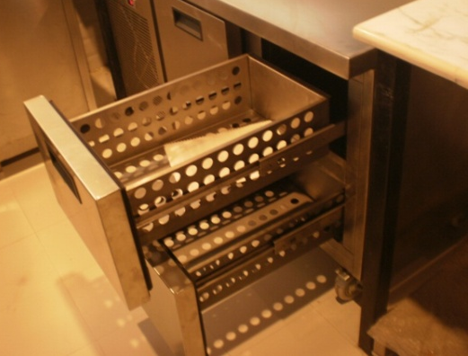








SUPERIOR QUALITY OF CONDENSER AND EVAPORATOR COILS
This ensures excellent energy efficiency since heat transfer is at its very best.
It also ensures zero break downs due to gas leaks when system is under pressure.
DRAWERS
Optional fully extendable work out drawer.
Sliders are SS 304 with a load bearing capacity of 70 kgs.
All sliders run on cam wheels, not ball bearings.
ADJUSTABLE SHELF HOLDERS
Fully adjustable shelves and shelf holders allow flexibility in loading and easy cleaning.

Slide 10
QUALITY POLICY
We are committed to deliver Quality products and services, to meet and exceed customers' expectations.
Our management and employees are involved in continually upgrading our work values through training and development of their skills in order to get the job done Right First Time, thereby eliminating rework.
Ultimately, quality is measured by our ability to meet and exceed our customers’ expectations. Customers are the final judge of quality. This is why our customers remain the focus of everything we do.
Because quality requirements are constantly changing, we remain committed to continuous improvement in every aspect of our operation.
By far, the most valuable resource at MG-PRO is our people. An experienced, highly skilled team of engineers, technicians, and managers. They are well trained, involved and individually committed to outstanding product quality and customer service.
In each step of the production process, we emphasize quality control. The result is a quality product, manufactured to meet or surpass all functional and aesthetic requirements.
By minimizing variability in our processes, we are able to build quality into all of our standard products and do so consistently.
Our products are supported by service that responds to our customers' needs. This involves on-time delivery, after-sale support and regular communication with our customers on quality issues
The Mukesh Ganjawalla Group has established and effectively communicated performance-based quality objectives and targets for all company departments. These quality objectives shall be implemented effectively and reviewed over time to dictate new improvements throughout the organization.
With this strategy, we can achieve the level of overall market performance - 'CUSTOMER DELIGHT' - that is required to excel and to achieve our financial goals.
OUR MISSION
To be amongst India’s most admired new generation Foodservice equipment manufacturers and suppliers; in our products, in the manner in which we service our clients, in our work ethics and in our culture of societal integration.
OUR VISION
To be an organization that continuously achieves economic value by optimizing resources through operational excellence, powered by technology, driven by innovation creating customer delight. Our goal is to establish ourselves as a brand that is an import replacement and a benchmark in providing refrigeration solutions in commercial and display equipment.

Slide 11







THE WORLDS BEST BRANDS

Slide 12




















We provide optimal solutions for:
Hotels, restaurants, bars, cafes & bakeries
Frozen foods & beverages
Food retail
Water purification
Water cooling

Slide 13
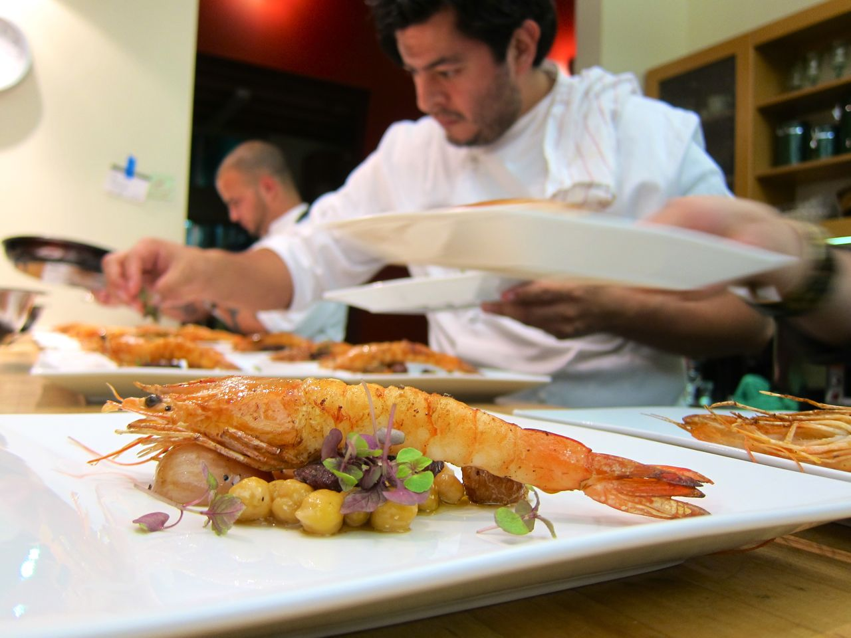
PROFESSIONAL REFRIGERATION SOLUTIONS
MGPRO brings to you, a truly world class range of Gastro-norm refrigeration products, that enhance the skills of modern kitchen professionals.
With MGPRO, you say good-bye to power-guzzling, rust-catching and crudely fabricated equipment and actually enjoy the benefits of sturdy equipment built with AISI 304 Grade Stainless Steel; flawless controls; reliable refrigeration system, energy saving design and enviable after sales service support. Some of the leading brands of hotels, restaurants and cafes fall back upon us for their requirements.

Slide 14
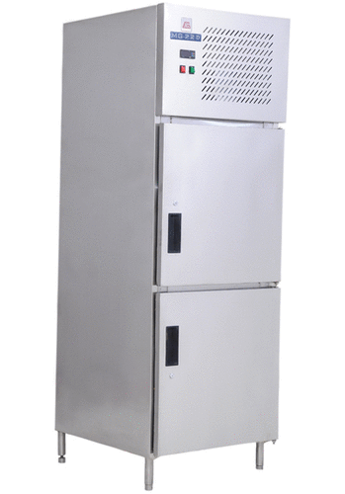
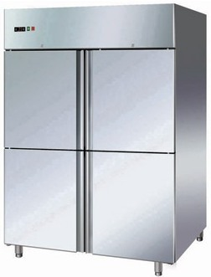
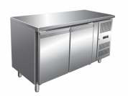
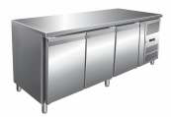

REFRIGERATED REACH IN CABINETS
MGPRO Reach In Cabinets suitable for 2 x GN 1/1 sizes are built in SS304 on the inside and outside (including the back and bottom), with reliable Emerson / Tecumseh compressors, LED temperature display, rounded internal edges for complete hygiene, removable magnetic gaskets for ease of cleaning, self closing doors with heaters to prevent condensation and heavy duty lockable castors.
Chillers or Deep Freezers available in one, two or four door options; a choice of Static or Ventilated refrigeration; and in 600 and 1100 ltr. capacities.
Available with glass doors and LED lights.
Available with one full door or two full doors too.
Also available with full doors
MG-GNDDVR (refrigerator)
MG-GNDDVF (freezer)
MG-GNDDDDVR (refrigerator)
MG-GNDDDDVF (freezer)
UNDERCOUNTERS
While retaining the basic features of the Reach in Cabinets mentioned above, these refrigerated work tables, mounted on heavy duty lockable castors, combine storage and preparation thereby enhancing the effectiveness of kitchen professionals and are suitable for GN 1/1 sizes. Chillers or Deep Freezers available in 2 and 3 door options.
MGPRO under counters come with the revolutionary Mono-Bloc refrigeration systems.
All models are available with Glass Doors
MG-GNDDUR (refrigerator)
MG-GNDDUF (freezer)
MG-GNDDUR (refrigerator)
MG-GNDDUF (freezer)

Slide 15
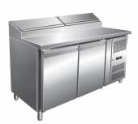
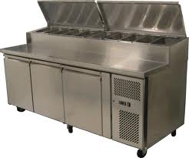
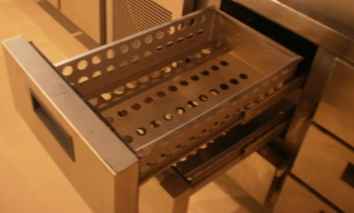
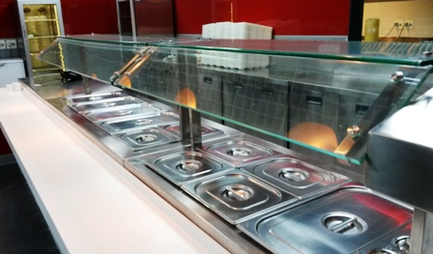


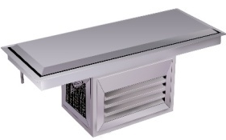
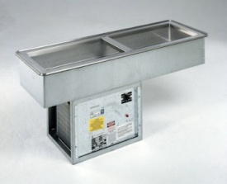
PREP STATIONS
MGPRO Prep Stations bring in a unique experience in the preparation of pizzas, salads, sandwiches, desserts and more. Mounted on heavy duty lockable castors or SS feet and available in 2 and 3, self closing door variants.
MG-GNDDPYY
MG-GNDDDPYY
All models are available with pull out Drawers. Drawer sliders are SS 304 with 70 kg load bearing capacity.
Standard prep stations come with DUAL COMPRESSORS for excellent performance and energy efficiency.
SALADETTES AND COUNTER TOP DISPLAYS
The Saladettes come with a refrigerated display top that can take in toppings, salads etc. in 10 x GN ¼ pans (not included). It also has a night cover. A two door refrigerated section underneath is handy to store additional foodstuff. The Countertop display comes with a glass sneeze guard; is equipped with its own refrigeration unit and accepts 5 GN ¼ pans (not included).
MG-T2 | MG-T3
DROP IN FROSTED TOPS AND COLD WELLS
MGPRO stainless steel drop in Frost Tops are ideal for presentation of cold cuts, cold desserts as also for display of raw fish on a bed of ice. The static Drop in Wells come with electronic control with digital display and can take in appropriate number of GN pans (not included) for toppings, salads etc. The drop ins give you complete flexibility of having panelling work around them in sync with your store design.
MG-RT
MG-R

Slide 16
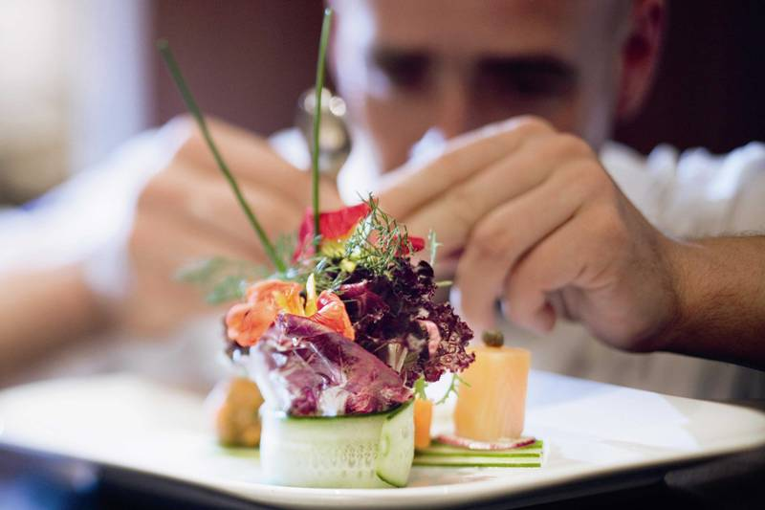
TECHNICAL SPECIFICATIONS
PRODUCT | MODEL | EXTERIOR DIMENSIONS (L x B x H / All in MM) | VOL (Ltrs.) | NET WEIGHT (Kgs) | NO OF DOORS | NO OF SHELVES | METHOD OF COOLING | TEMPERATURE RANGE (Degrees C) | INPUT POWER | REFRIGERANT
REACH IN's | MG-GNDDVR | 742 x 853 x 2152 | 600 | 120 | 2 | 4 | No frost | -2 to +2 | 675 | R134a
 | MG-GNDDVF | 742 x 853 x 2152 | 600 | 120 | 2 | 4 | Static | -15 to -18 | 580 | R404a
 | MG-GNDDDDVR | 1422 x 853 x 2152 | 1100 | 150 | 4 | 8 | No frost | +2 to +4 | 925 | R134a
 | MG-GNDDDDVF | 1422x 853 x 2152 | 1100 | 160 | 4 | 8 | Static | -15 to -18 | 1000 | R404a
UNDER COUNTERS | MG-GNDDUR | 1415 x 748 x 864 | 330 | 105 | 2 | 4 | No frost | -2 to +2 | 450 | R134a
 | MG-GNDDDUR | 1870 x 748 x 864 | 500 | 125 | 3 | 6 | No frost | -2 to +2 | 615 | R134a
 | MG-GNDDUF | 1415 x 748 x 864 | 330 | 105 | 2 | 4 | No frost | -15 to -18 | 385 | R404a
 | MG-GNDDDUF | 1870 x 748 x 864 | 500 | 125 | 3 | 6 | No frost | -15 to -18 | 580 | R404a
PREP STATIONS | MG-GNDDPYY | 1415 x 748 x 864 + 125 | 390 | 155 | 2 | 4 | No frost | +2 to +4 | 450 | R134a
 | MG-GNDDDPYY | 1870 x 748 x 864 + 125 | 560 | 164 | 3 | 6 | No frost | +2 to +4 | 615 | R134a
 | MG-GNDDZYY | 1415 x 864 x 864 + 175 | 410 | 155 | 2 | 4 | No frost | +2 to +4 | 450 | R134a
 | MG-GNDDDZYY | 1415 x 864 x 864 + 175 | 580 | 164 | 3 | 6 | No frost | +2 to +4 | 615 | R134a
THERMOWELLS | MG-T2 | 1415 x 457 x 206 | 60 | 28 | 1 | NA | Static | +2 to +4 | 360 | R134a
 | MG-T3 | 1870 x 457 x 206 | 75 | 34 | 1 | NA | Static | +2 to +4 | 375 | R134a
FROSTED TOPS / WELLS | MG-RT | 1150 x 450 x 400 | NA | 35 | NA | NA | Static | +2 to +4 | 375 | R134a
 | MG-R | 1100 x 450 x 273 + 324 | 140 | 39 | NA | NA | Static | +2 to +4 | 375 | R134a
Cupboard refrigerator | MG-CBR | 600 x 640 x 864 | 120 | 70 | 1 | 2 | Static | +2 to +4 | 375 | R404a
Cupboard freezer | MG-CBF | 600 x 640 x 864 | 120 | 70 | 1 | 2 | Static | -15 to -18 | 205 | R404a
All products are tested to perform under ambient temperature of 43°C
With a view to ensure ongoing product enhancement / development, MGPRO reserves the right to change any specifications, without prior notice.

Slide 17
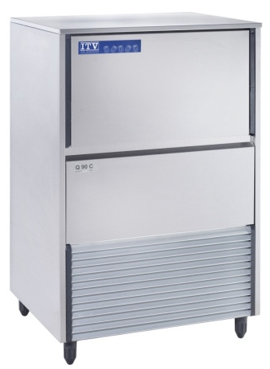
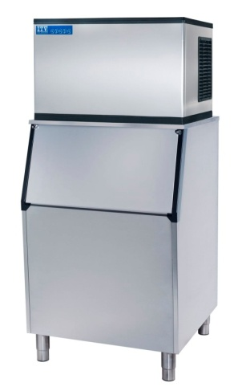
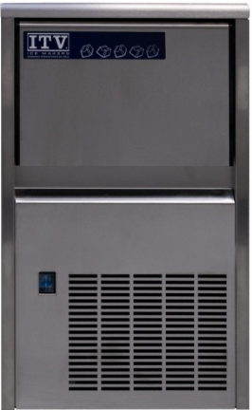
Blast Chillers & Freezers
The Blast Chillers are offered and supplied from FAGOR INDUSTRIAL with capacities ranging from 20 KG Load to 100 KG load in Standalone self contained models and up to 200 KG per Load in Remote and Roll In Models. These Blast Chillers/Freezers are most ideal for reducing the temperature of cooked food from 90°C to +3°C or –18°C rapidly thereby rendering it safe from bacterial growth and fit for ensuing storage and consumption later on.
Ice Makers with Built-In Storage Bin
Appreciated by commercial outlets where space is at a premium, the self contained FAGOR / ITV Ice Machines represent the best options for bars, coffee shops and restaurants. Most of these models can be placed under the counter. They produce gourmet ice cubes with no hole that is thimble shaped, transparent and slow melting. Round ice cubes enhance the flavour of all drinks; have a greater eye-appeal and extend the chilling effect for a longer period of time. These ice cubes are made in machines with the latest SRAY SYSTEM TECHNOLOGY and Horizontal Evaporator coil.
Capacities available
50 Kgs
100 Kgs
200 Kgs
All capacities are per 24 hours.

Slide 18
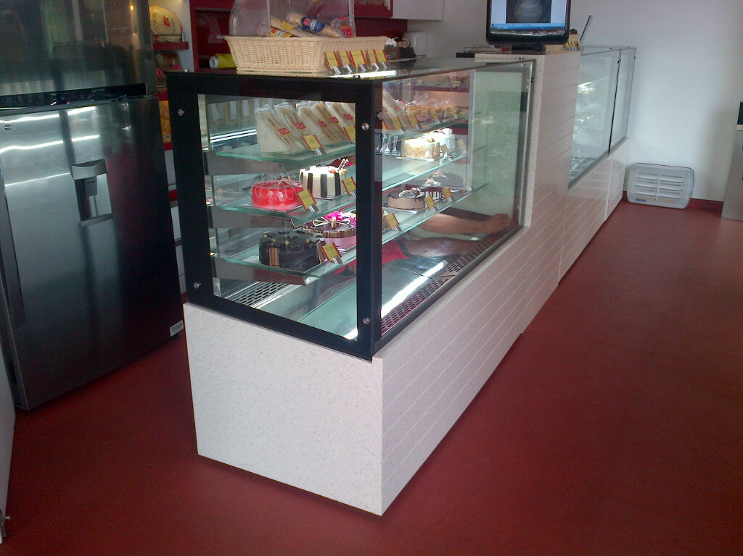
The best confectionary makers happily entrust their creations to MGPRO technology.
Have to look at the stunning features of the MGPRO display cases to know why.

Slide 19
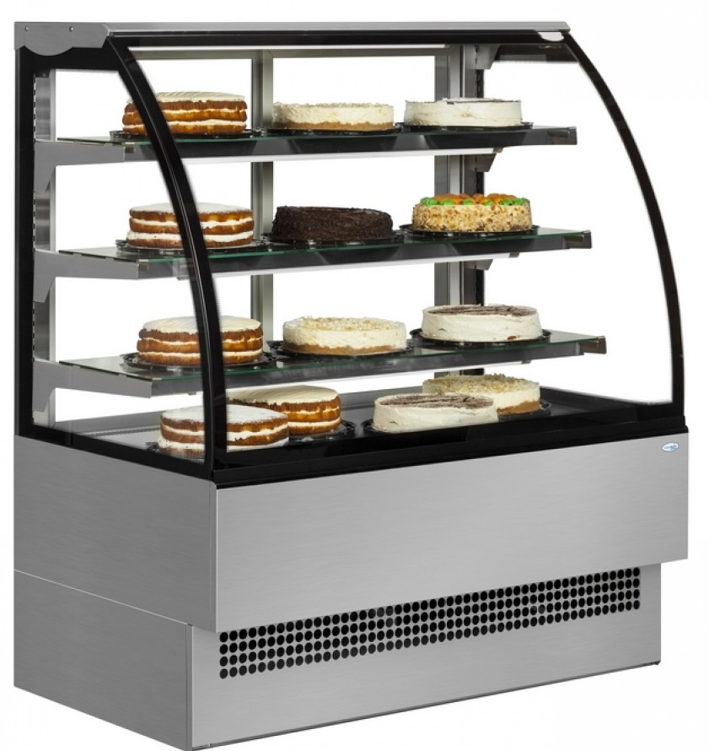
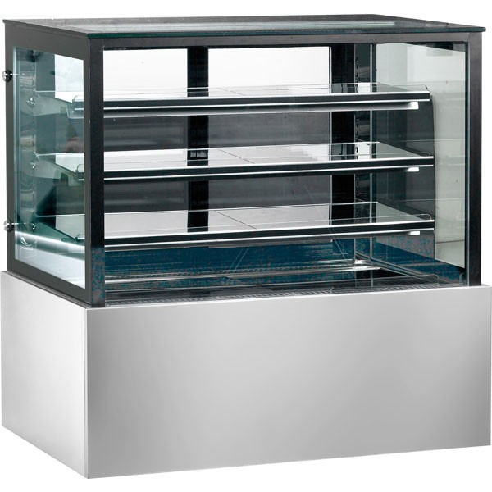
Showcases that are a class apart with special air heated front glass that blend technology with aesthetic appeal and designed to increase your sales.
Suitable for refrigerated display and retail of Cakes, Pastries, Indian Desserts, Milk Products, Cheese, Cold Cuts, Sandwiches, etc. in Hotel Coffee Shops, Cafés, Pastry Shops, Ice-cream Parlours, Bakeries, Food Courts and Sweet Shops. Designed to adapt to any space, large or small, they are also available in “Hot” and “Ambient Temperature” versions to give a uniform and an international look to your store.
Curved glass models:
MG-VENUS3
MG-VENUS4
MG-VENUS5
Straight glass models:
MG-MARS3
MG-MARS4
MG-MARS5
ALL MODELS ARE AVAILABLE WITH SINGLE GLASS OR DOUBLE VACUUM GLASS
AIR HEATED FRONT GLASS FOR ANTI CONDENSATION AVAILABLE

Slide 20
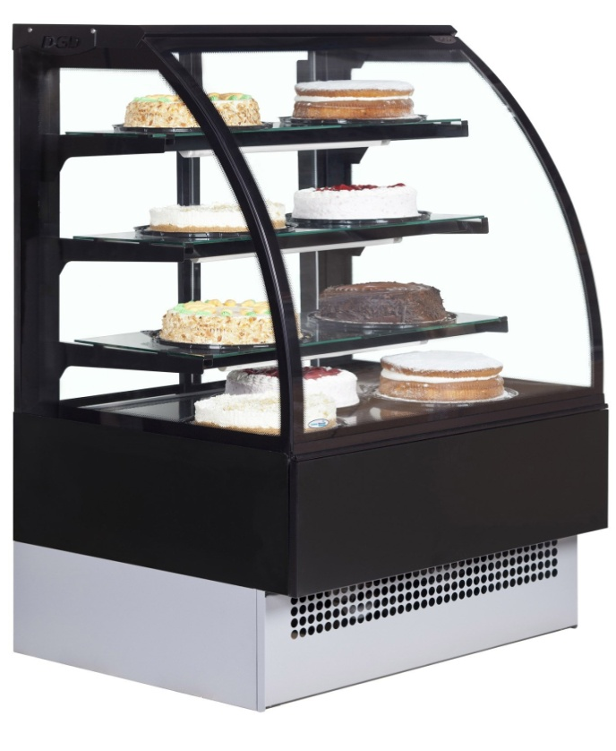
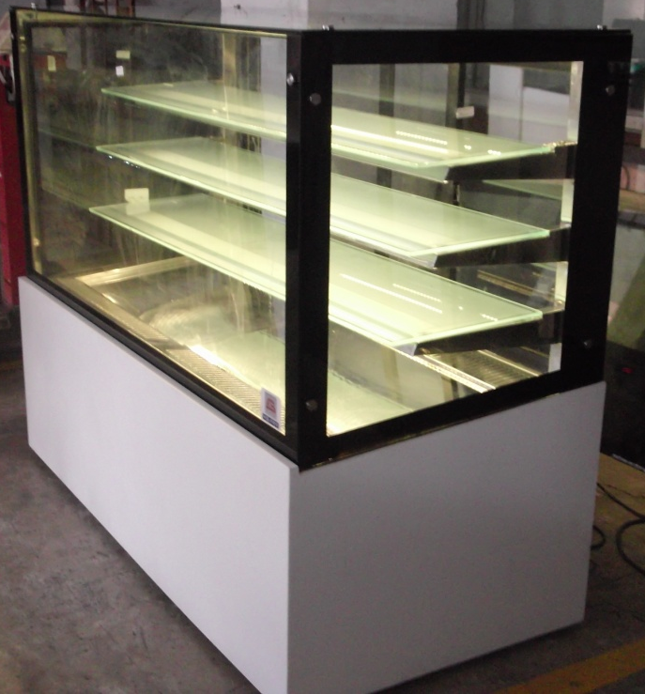
SPECIAL FEATURES
Special air heated front glass that enhances visibility and prevents
unhygienic condensation.
Automatic defrosting system.
Choice of eye catching and elegant base in black/white glass or
stainless steel.
Low energy and heat LED Illuminated shelves.
Ventilated refrigeration ensures uniform cooling.
Digital temperature display.

Slide 21
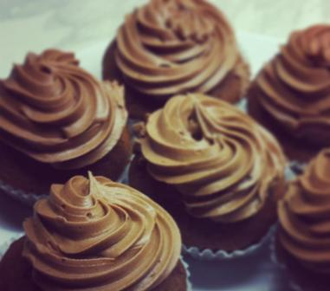

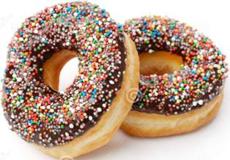
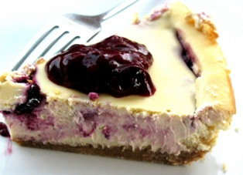
TECHNICAL SPECIFICATIONS
PRODUCT | MODEL | NO OF SHELVES | EXT DIMENSIONS (L x B x H / All in MM) | Input Power (WATTS) | TEMPERATURE RANGE (Deg C) | AMBIENT TEMPERATURE (Deg C)
Straight glass showcase | MG-MARS3 | Base + 3 shelves | 915 x 700 x 1310 | 450 | +4 to +8 | 26
Straight glass showcase | MG-MARS4 | Base + 3 shelves | 1200 x 700 x 1310 | 450 | +4 to +8 | 26
Straight glass showcase | MG-MARS5 | Base + 3 shelves | 1524 x 700 x 1310 | 615 | +4 to +8 | 26
Curved glass showcase | MG-VENUS3 | Base + 3 shelves | 915 x 700 x 1310 | 450 | +4 to +8 | 26
Curved glass showcase | MG-VENUS4 | Base + 3 shelves | 1200 x 700 x 1310 | 450 | +4 to +8 | 26
Curved glass showcase | MG-VENUS5 | Base + 3 shelves | 1524 x 700 x 1310 | 615 | +4 to +8 | 26
Common Specifications
Method of cooling: No Frost
Defrosting: Automatic
All models are on swivel/brake castors
All glasses are toughened
Exterior finish can be customised with Black or White Glass or Corian Stone

Slide 22
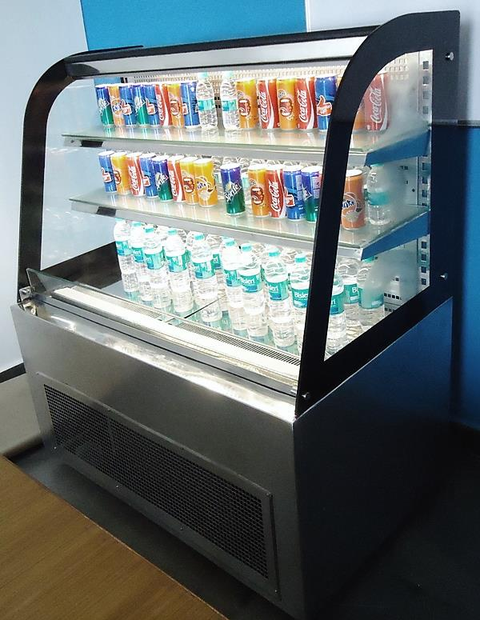
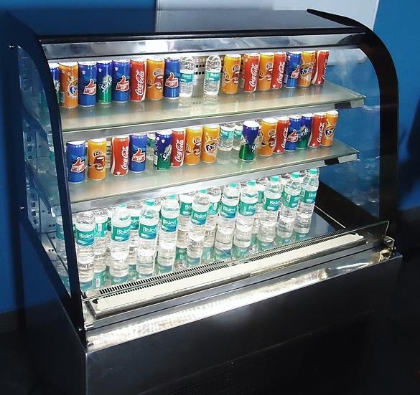
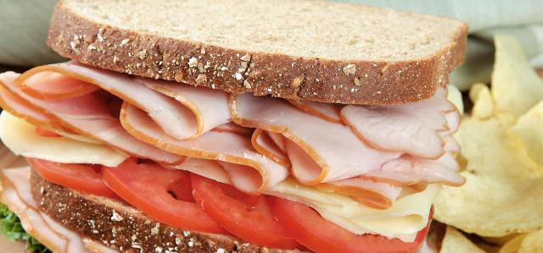
MULTIDECK COOLERS
Multideck coolers are one of the most popular refrigerated merchandisers for coffee shops, supermarkets, hotels, schools, universities, delicatessens, restaurants and hospitals. With the increase in ‘grab & go’ service, our Multideck coolers have never been in such demand!
Their designer style improves your front of house, while their clever layout maximizes every millimeter of retail space. MGPRO’s Multideck range are perfect for front of house display, enhancing presentation and giving customers open, easy access to drinks, pre-packed snacks and dairy products.

Slide 23
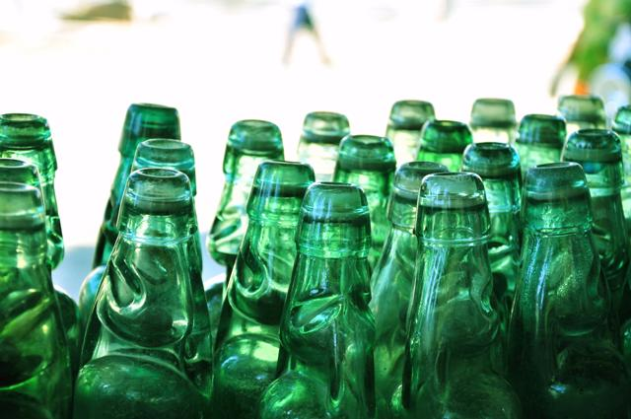
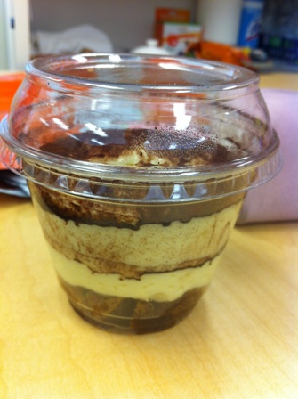
KEY FEATURES
ENERGY SAVING
Setting new standards: To help reduce energy consumption we’ve introduced LED lighting as standard across the entire showcases and multideck coolers range. As well as cutting power consumption, they make the display look even more attractive and if you want the ultimate in energy efficiency, our optional front opening doors deliver substantial energy savings.
OPERATING TEMPERATURE
The ideal operating temperature in all multideck coolers is +4 to +6 degrees celcius at an ambient temperature of 26 degrees celcius.
MOBILITY
All multideck coolers and showcases are built with swivel and brake (no mark leaving) castors. This makes it easier for moving them around or to clean the area below the multideck cooler.
ADJUSTABLE SHELVES
All multideck coolers come with two glass shelves plus the bottom. The glass shelves are easily adjustable in height as per the requirement / application.
OPTIONAL / EXTRA
  Extra glass shelf is available.
  Extra lighting.
  Roll-down night blind.
  Opening glass doors.
  Front digital temperature display

Slide 24
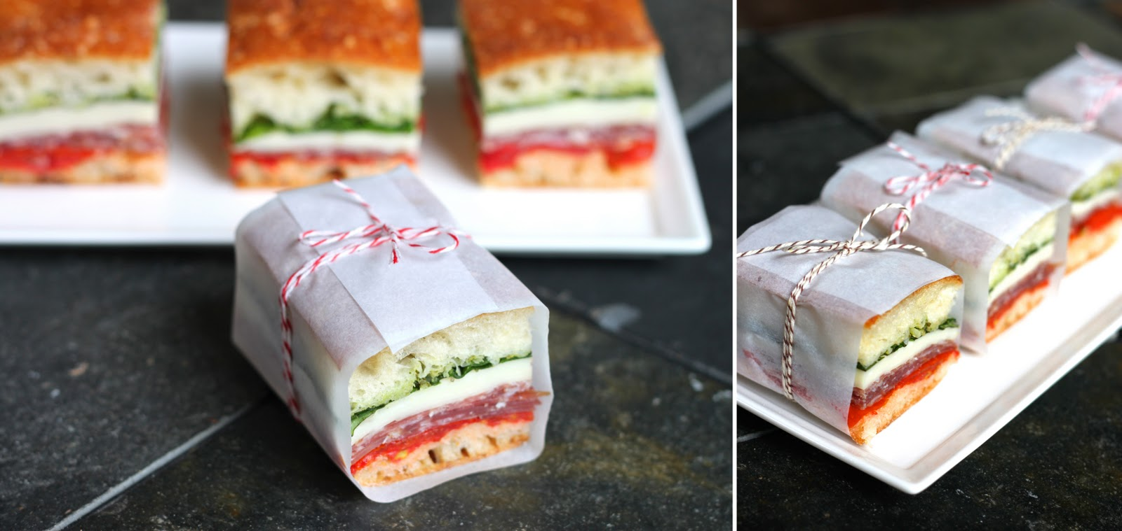

TECHNICAL DATA
Outer Dimensions | 48 x 27.56 x 51.57 inch
Temperature Range | +4 to +8 degrees C
Ambient temperature | 26 degrees C
No. of Shelves | Two toughened black glass shelves
Specification of SS used for Inner Tank / Outer Body | SS 304
Specification of Glass | Toughened glass
Specification of Light | Water proof strip LED
Condensing Unit | No frost cooling
Refrigerant | R 134a
Material for structural work & body | SS 202
Frost free refrigeration system with soft cold airflow with blow fans | Yes
Electronic digital temperature controller with automatic defrost | Yes
Fibber Castors wheels | Two with brakes & two without brakes.

Slide 25
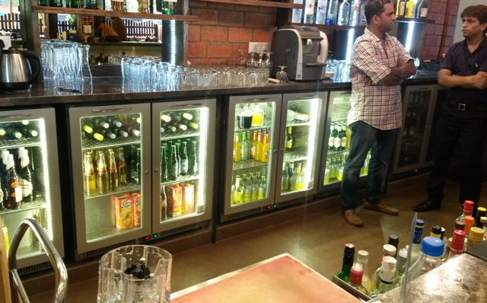
BACK BAR COOLERS
Coping with the demands of a busy venue means Beverage counters ought to operate efficiently, to maintain temperature as bottles are taken out, stocks are replenished and doors are continually opened and closed. It also has to be robust enough to survive a punishing level of wear and tear.
The latest Beverage counters of MGPRO have been designed with these testing demands in mind. However they are also designed to look stylish and display premium bottled drinks to eye-catching effect.
Available as a one, two or three door model, the MGPRO Back Bar Coolers are capable of storing up to 270 nos. of 330ml bottles at 4°C to 10°C

Slide 26

KEY FEATURES
Built to last…entire body is made of stainless steel
Water proof Digital LED temperature display
LED lights for illumination
Automatic defrosting
No frost cooling for uniformity in temperature
Pre Buffed premium perforated Stainless steel shelves
Fitted with anti-condensation double glazed Argon gas glass door
Electric Mullion heaters for anti water dripping
Easy to clean / replace press type door gaskets

Slide 27
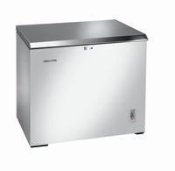
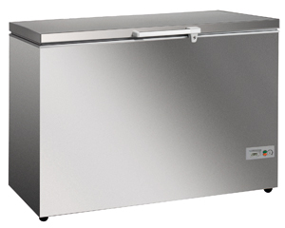
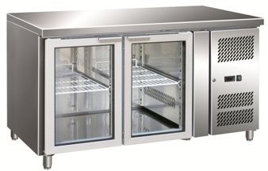
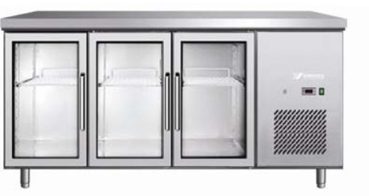


TOP OPENING CHILLERS
A range of top loading chillers, designed for quick service and easy restocking of chilled beer and beverage bottles.
MG-C200
MG-C400
UNDER COUNTER REFRIGERATORS
Elegant yet reliable Under counter Back Bars made in sturdy stainless steel that are designed to enhance the efficiency of professional bartenders. Perfect for showcasing bottled and canned drinks and giving you high capacity & high visibility storage and display options.
MG-GNKKUR
MG-GNKKUR

Slide 28
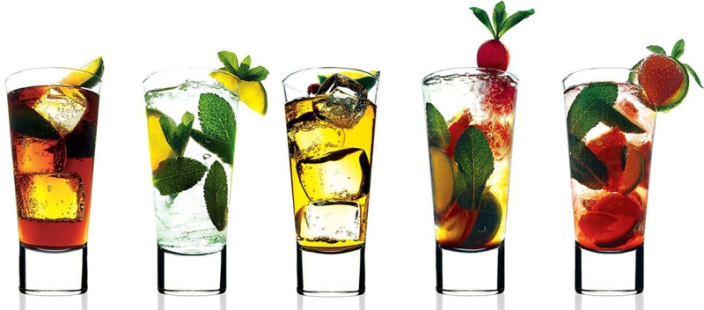
TECHNICAL SPECIFICATIONS
PRODUCT | MODEL | EXTERIOR DIMENSIONS (L x B x H / All in MM) | VOLUME (Ltrs.) | NET WEIGHT (Kgs) | NO OF BOTTLES | TEMPERATURE RANGE (Degrees C) | INPUT POWER | REFRIGERANT
BACK BAR COOLERS | MG-BBK1 | 457 x 610 x 915 | 150 |  |  | +4 to +6 | 375 | R134a
 | MG-BBK2 | 900 x 610 x 915 | 280 |  |  | +4 to +6 | 450 | R134a
 | MG-BBK3 | 1372 x 610 x 915 | 360 |  |  | +4 to +6 | 615 | R134a
VISI COOLERS | MG-VBK1 | 660 x 686 x 1829 | 400 |  |  | +4 to +6 | 615 | R134a
 | MG-VBK2 | 1320 x 686 x 1829 | 750 |  |  | +4 to +6 | 615 | R134a
TOP OPENING CHILLERS | MG-C100 |  |  |  |  | +2 to +4 | 325 | R134a
 | MG-C200 |  |  |  |  | +2 to +4 |  | R134a
 | MG-C300 |  |  |  |  | +2 to +4 |  | R134a
 | MG-C400 |  |  |  |  | +2 to +4 | 325 | R134a

Slide 29
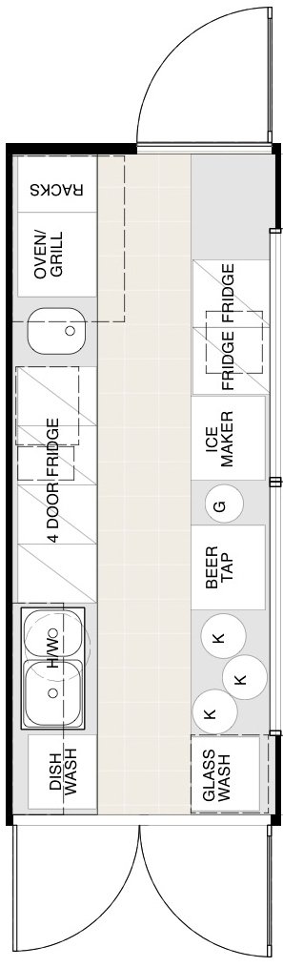
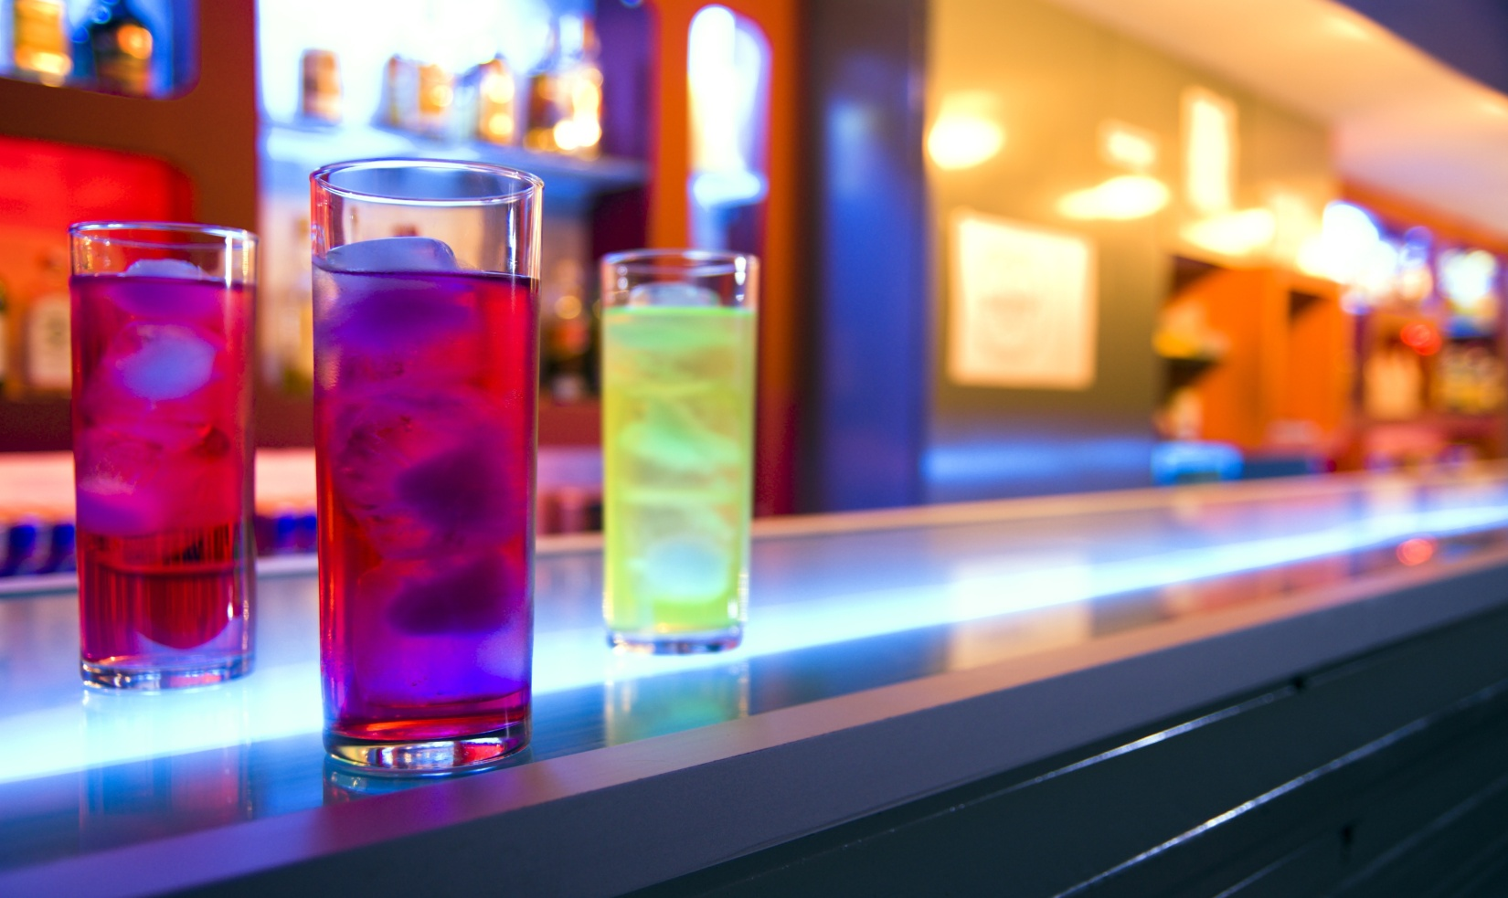
Bars and Coffee Shops
A well designed bar or a coffee shop will reduce your operational costs, increase sales, provide outstanding customer service and improve your profits.
We can help you on choosing and installing the correct equipment to best accomplish these tasks for your bar or coffee shop so you can reduce labour costs, enhance productivity of your staff, promote great customer service, create happy customers and increase profits.

Slide 30
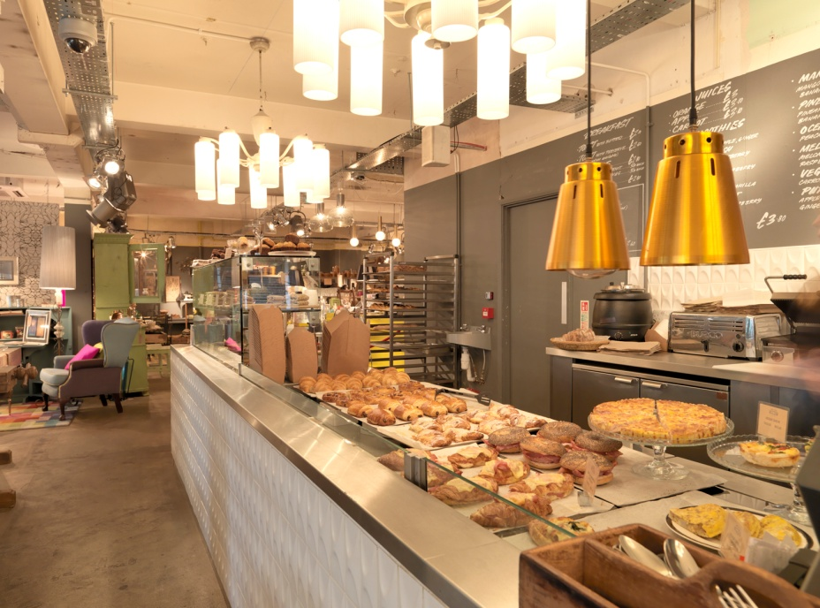


Project Management
Be it a bar, coffee shop, or a large commercial kitchen; MGPRO can help you transform your plans with a touch of professionalism.
Commercial Kitchens
MGPRO has a demonstrated capability to execute large kitchen projects that cover professional refrigeration, café/bar equipment and a comprehensive array of hot / cooking products. It has strong testimonials that include names like the Sarovar Hotels, Taj Hotels, Marriott Hotels, Hyatt, Holiday Inn, Torrent Pharmaceuticals and so on.

Slide 31

Contact Information
Corporate Office:
Hospitality Appliances Pvt. Ltd.
Ground floor, Hema House,
Chandawarkar road, Opposite Dattani trade centre,
Borivali West, Mumbai 400091,
Maharashtra, India.
Email: sales@hapl.co.in / mukeshganjawalla@yahoo.com
Tel. +91 22 28959893 / 9894
Website: www.hapl.co.in
Factory / Works:
Ganjawalla FabriPro Pvt. Ltd.
Plot No. 47, Government Industrial estate (Phase 2),
Piparia, Silvassa, UT of Dadra & Nagar Haveli, India
Email: gfpl.silvassa@gmail.com
Tel. +91 260 2640989 / 2641989
Allow adequate space for maintenance and ventilation. All refrigeration equipment requires adequate ventilation for efficient and effective performance. MGPRO reserves the right to modify the design, materials and finish in accordance with its progressive development policy.
MADE IN INDIA…FOR INDIA!
WWW.MGPRO.IN

